Slide 1
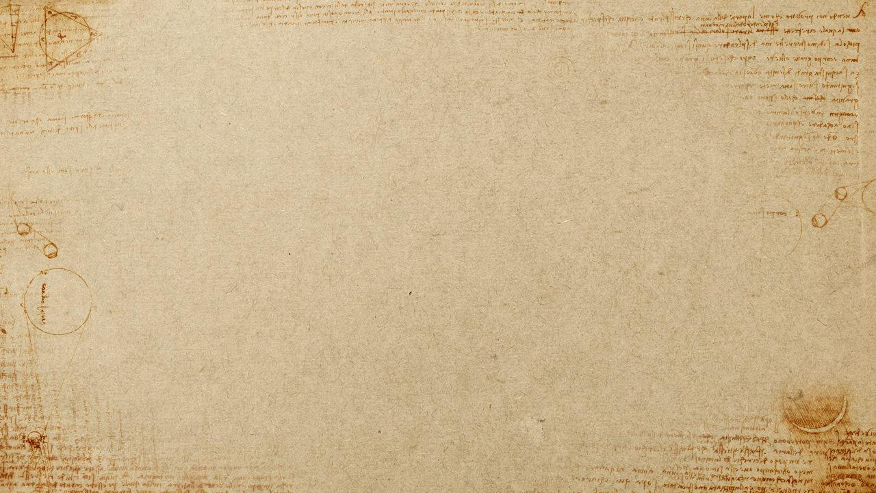
Overreaching question should be “Does this class increase participants knowledge about PERIOD information, work practices, crafting, processes, etc…” If not, can you explain why this is still a class appropriate for an SCA setting. Examples of that could be classes in the SCA studies division.
Who: What group of people are we talking about here? The Mongols, Vikings, etc? Make sure that class participants know how this relates to medieval life. Is there a certain type of person that this class relates to? Royalty, craftspeople, everyday Persian life?
What: There should be a synopsis of the class on any handouts. What exactly is the goal of the class? Are we working on period Islamic bookbinding? Medieval mathematics? Let the students know what the outcome is going to be.
When: Very important as we do have a defined period that we are looking at in the SCA, be sure that the students know the exact time period this class is referencing.
Where: What geographic location does the information in this class pertain to? Some things may be very specific like “This is from a find in Gotland” or broader as in all of Europe in the 12th century.
Why: Why are we talking about this? What historical significance does this information have? These are questions that each teacher should be able to answer about the class being taught.
How: Usually the meat of a crafting class here, be sure to outline how you are doing this process vs. how the process would have been done in a period fashion. Be sure to explain why we do it this way instead of the period way…ex. We know arsenic is bad so we don’t use that in crafts anymore.

